Slide 1
AWS Services
Abhirup Khanna

Slide 2
Introduction
Amazon Web Services (AWS) is a cloud computing platform that provides a wide range of services to businesses and individuals.
AWS is designed to be flexible, scalable, and cost-effective, providing businesses with the ability to run their applications and services in the cloud.
One of the key features of AWS is its breadth of services. AWS offers over 200 services, including compute, storage, databases, analytics, machine learning, networking, security, and more.
These services can be used individually or in combination, allowing businesses to create customized solutions that meet their specific needs.

Slide 3
Introduction
AWS provides businesses with a high level of flexibility.
With AWS, businesses can choose from a variety of computing resources, from virtual machines to serverless computing platforms.
AWS also provides businesses with the ability to easily scale their computing resources up or down to meet changing demands, without needing to invest in additional hardware.

Slide 4
Introduction
AWS is also designed to be cost-effective. With AWS, businesses only pay for the resources they use, and they can easily adjust their usage to stay within their budget.
AWS also provides businesses with tools to help them optimize their costs, such as cost explorer and AWS budgeting.
Another key feature of AWS is its security.
AWS has a wide range of security protocols in place to protect against cyber attacks and data breaches, including physical security measures, network security, access controls, and data encryption.
AWS also offers a variety of compliance certifications, including PCI DSS, HIPAA, and SOC 2, making it a popular choice for businesses in regulated industries.

Slide 5
Features of AWS
Flexibility: The flexibility of AWS allows us to choose which programming models, languages, and operating systems are better suited for their project, so we do not have to learn new skills to adopt new technologies.
Cost-effective: Cost is one of the most important factors that need to be considered in delivering IT solutions. For example, developing and deploying an application can incur a low cost, but after successful deployment, there is a need for hardware and bandwidth.

Slide 6
Features of AWS
Scalable and elastic: Scalability in aws has the ability to scale the computing resources up or down when demand increases or decreases respectively. Elasticity in aws is defined as the distribution of incoming application traffic across multiple targets such as Amazon EC2 instances, containers, IP addresses.
Secure: AWS incorporates the security into its services, and documents to describe how to use the security features.

Slide 7
Features of AWS
Experienced: AWS has built an infrastructure based on lessons learned from over sixteen years of experience managing the multi-billion dollar Amazon.com business.
Amazon continues to benefit its customers by enhancing their infrastructure capabilities.
Nowadays, Amazon has become a global web platform that serves millions of customers, and AWS has been evolved since 2006, serving hundreds of thousands of customers worldwide.

Slide 8
EC2
EC2 stands for Amazon Elastic Compute Cloud.
Amazon EC2 is a web service that provides resizable compute capacity in the cloud.
Amazon EC2 reduces the time required to obtain and boot new user instances to minutes rather than in older days, if you need a server then you had to put a purchase order, and cabling is done to get a new server which is a very time-consuming process.
Now, Amazon has provided an EC2 which is a virtual machine in the cloud that completely changes the industry.

Slide 9
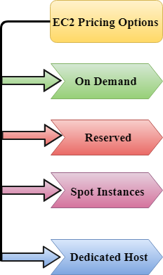
EC2 Pricing Options

Slide 10
On Demand
It allows you to pay a fixed rate by the hour or even by the second with no commitment.
Linux instance is by the second and windows instance is by the hour.
On Demand is perfect for the users who want low cost and flexibility of Amazon EC2 without any up-front investment or long-term commitment.
It is suitable for the applications with short term, spiky or unpredictable workloads that cannot be interrupted.

Slide 11
Reserved
It is a way of making a reservation with Amazon or we can say that we make a contract with Amazon. The contract can be for 1 or 3 years in length.
In a Reserved instance, you are making a contract means you are paying some upfront, so it gives you a significant discount on the hourly charge for an instance.
It is useful for applications with steady state or predictable usage.
It is used for those applications that require reserved capacity.

Slide 12
Spot Instance
It allows you to bid for a price whatever price that you want for instance capacity, and providing better savings if your applications have flexible start and end times.
Spot Instances are useful for those applications that have flexible start and end times.
EC2 Spot Instances provide less discounts as compared to On Demand prices.
Spot Instances are used to optimize your costs on the AWS cloud and scale your application's throughput up to 10X.

Slide 13
Dedicated Hosts
A dedicated host is a physical server with EC2 instance capacity which is fully dedicated to your use.
The physical EC2 server is the dedicated host that can help you to reduce costs by allowing you to use your existing server-bound software licenses.
For example, Vmware, Oracle, SQL Server depending on the licenses that you can bring over to AWS and then they can use the Dedicated host.
Dedicated hosts are used to address compliance requirements and reduces host by allowing to use your existing server-bound server licenses.
It can be purchased as a Reservation for up to 70% off On-Demand price.

Slide 14
EBS
EBS stands for Elastic Block Store.
EC2 is a virtual server in a cloud while EBS is a virtual disk in a cloud.
Amazon EBS allows you to create storage volumes and attach them to the EC2 instances.
Once the storage volume is created, you can create a file system on the top of these volumes, and then you can run a database, store the files, applications or you can even use them as a block device in some other way.

Slide 15
S3
S3 stands for Simple Storage Service.
S3 is a safe place to store the files.
It is Object-based storage, i.e., you can store the images, word files, pdf files, etc.
The files which are stored in S3 can be from 0 Bytes to 5 TB.
Files are stored in Bucket. A bucket is like a folder available in S3 that stores the files.

Slide 16
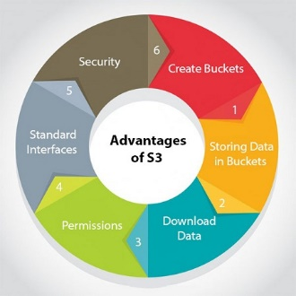
S3
S3 is a universal namespace, i.e., the names must be unique globally. Bucket contains a DNS address. Therefore, the bucket must contain a unique name to generate a unique DNS address.

Slide 17
VPC
VPC stands for Virtual Private Cloud.
Amazon Virtual Private Cloud (Amazon VPC) provides a logically isolated area of the AWS cloud where you can launch AWS resources in a virtual network that you define.
You have complete control over your virtual networking environment, including a selection of your IP address range, the creation of subnets, and configuration of route tables and network gateways.

Slide 18
Applicability of VPC
Launch instances in a subnet of your choosing. We can choose our own subnet addressing.
We can assign custom IP address ranges in each subnet.
We can configure route tables between subnets.
We can create an internet gateway and attach it to our VPC.
It provides much better security control over your AWS resources.

Slide 19
AWS Services
Amazon CloudFront: CloudFront is a content delivery network (CDN) that allows businesses to distribute content to users around the world. CloudFront speeds up the delivery of content by caching it at edge locations, reducing latency and improving performance.
Amazon Simple Notification Service (SNS): SNS is a messaging service that allows businesses to send and receive messages between software components and systems.

Slide 20
AWS Services
Amazon Relational Database Service (RDS): RDS is a managed database service that allows businesses to set up, operate, and scale relational databases in the cloud. RDS supports popular database engines like MySQL, PostgreSQL, and SQL Server.
Amazon Identity and Access Management (IAM): IAM is a service that allows businesses to manage user access and permissions to AWS resources. IAM enables businesses to create and manage users, groups, and roles, and control access to AWS resources based on policies and permissions.

Slide 21
AWS Lambda
AWS Lambda is a serverless computing service provided by Amazon Web Services (AWS) that allows users to run code without the need to provision or manage servers.
With Lambda, users can run code in response to events, such as changes to data in an Amazon S3 bucket or a message being sent to an Amazon Simple Notification Service (SNS) topic.
Lambda functions are written in programming languages such as Node.js, Python, Java, C#, and Go, and are triggered by various events.
When an event occurs, the Lambda function is automatically executed and runs on AWS infrastructure, which automatically scales to handle the load.

Slide 22
AWS Lambda
One of the benefits of using Lambda is that users only pay for the compute time that their code consumes, and there are no upfront costs or ongoing maintenance fees.
Additionally, Lambda provides automatic scaling, fault tolerance, and high availability, ensuring that code is always available to respond to events.
Lambda can be used for a wide range of use cases, such as processing data from IoT devices, analyzing logs, creating serverless APIs, and automating workflows.
Lambda integrates with many other AWS services, such as Amazon S3, Amazon DynamoDB, and AWS Step Functions, allowing users to create complex serverless applications that are easy to manage and scale.

Slide 23
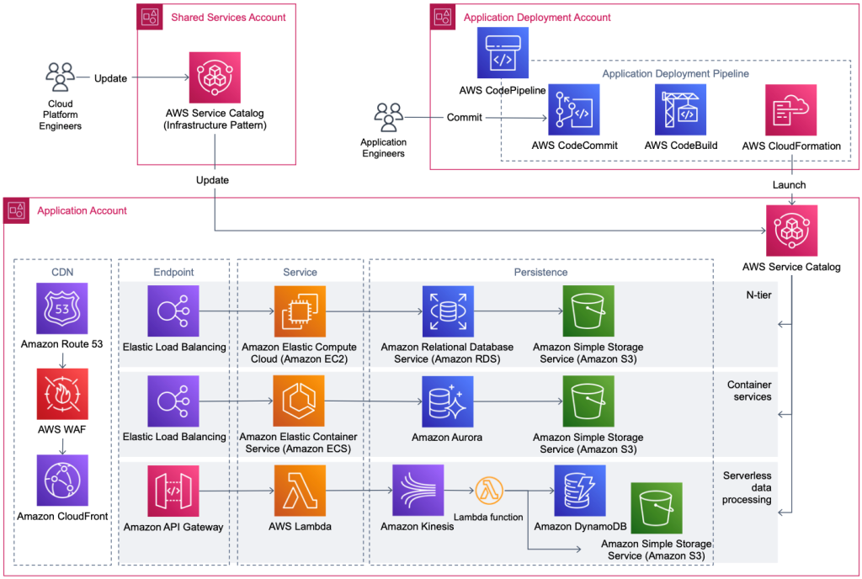
AWS Service Catalog

Slide 24
Growth of AWS Services
Healthcare: Healthcare providers have been adopting AWS services for storage, analytics, and machine learning. According to a report by MarketsandMarkets, the healthcare cloud computing market is expected to grow from $19.5 billion in 2020 to $64.7 billion by 2025, with AWS being a major player in the market.
Finance: Financial institutions use AWS services for security, data storage, and analytics. According to a survey by Deloitte, 94% of financial institutions use cloud computing, and AWS is the leading provider of cloud services in the financial services sector.

Slide 25
Growth of AWS Services
Retail: Retailers use AWS services for e-commerce, inventory management, and supply chain management. Amazon.com, which is owned by AWS's parent company Amazon, is one of the largest online retailers in the world and uses AWS services extensively.
Education: Educational institutions use AWS services for online learning platforms, student analytics, and research. According to a report by ResearchAndMarkets, the education cloud market is expected to grow from $8.13 billion in 2020 to $25.36 billion by 2025, with AWS being a major player in the market.

